Slide 1
Convolutional Neural Network - CNN
Outline
Why convolutional neural network
Comparison of ANN with CNN in a simple example
The structure of convolutional neural network
- What is filter or convolution
- What is stride
- What is padding
- What is pooling (Max and Average pooling)
Looking at different CNN structure (i.e. AlexNet, GoogleNet, ResNet, …)
How to code convolutional neural network in python
Hands on project
- What is transfer learning
- Apply convolutional neural network for image classification

Slide 2
Why convolutional neural network
Convolutional neural networks (CNNs) inspired by the study of the brain’s visual cortex.
Huble and Wiesel (1958) showed that many neurons in the visual cortex have a small local receptive field . More specifically they showed that some neurons react only to images of horizontal lines while others react only to lines with different orientations.
They also showed some neurons might have larger receptive fields and they react to more complex patterns that are combinations of the lower-level patterns.
CNNs has been used in image recognition since the 1980s.
Image search service, self-driving cars, automatic video classification systems.

Slide 3
Why convolutional neural network
Why not simply use a deep neural network with fully connected layers for image recognition task?`
This might work for small images
It breaks down for large images because of the huge number of required parameters
As an example:
Suppose we have a 100 by 100 – pixel image that has 10,000 pixels.
The input layer should have 10,000 neurons
If we only have one hidden layer with a 1000 neurons in it, then for the fully connected network with just one layer we have at least 10,000,000 connections. CNNs solve this problem using partially connected layers and weight sharing.

Slide 4
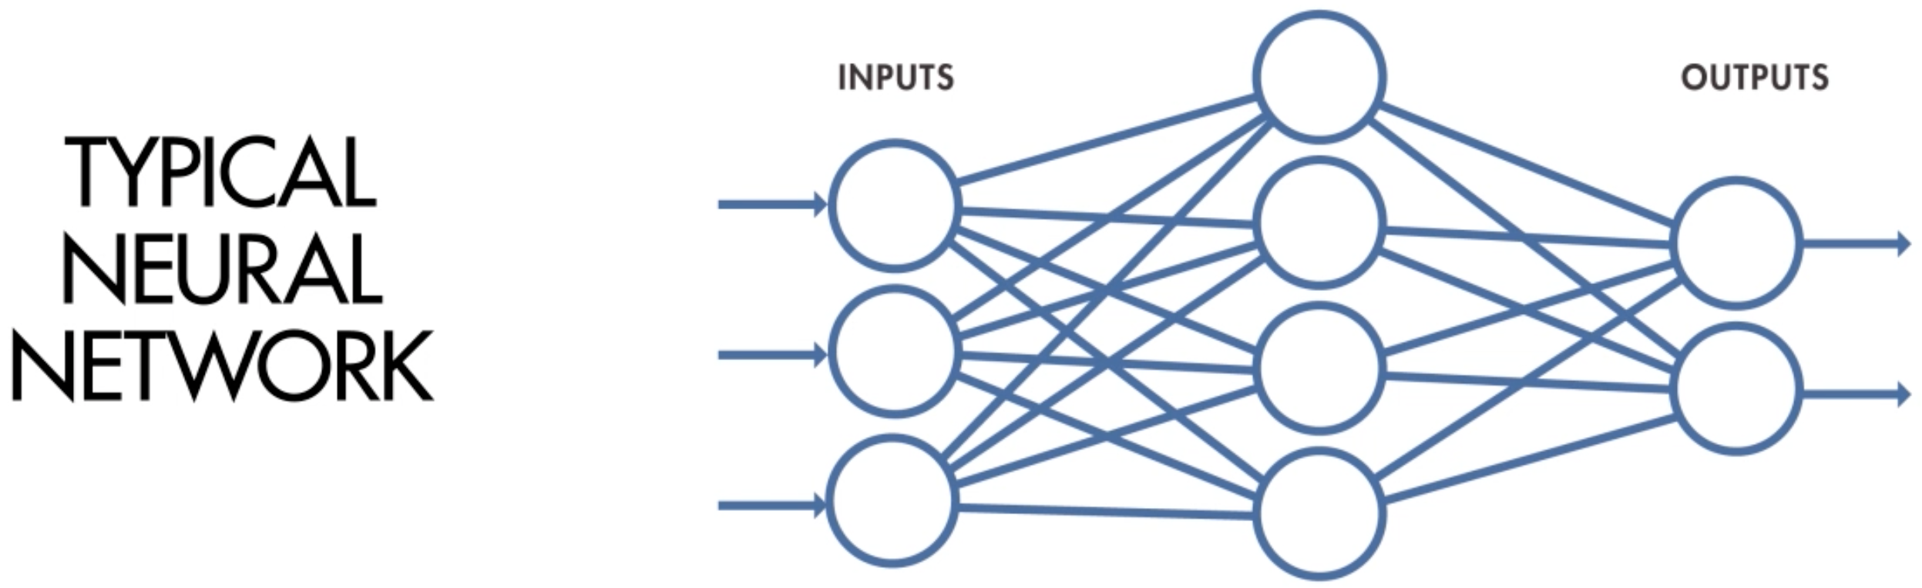
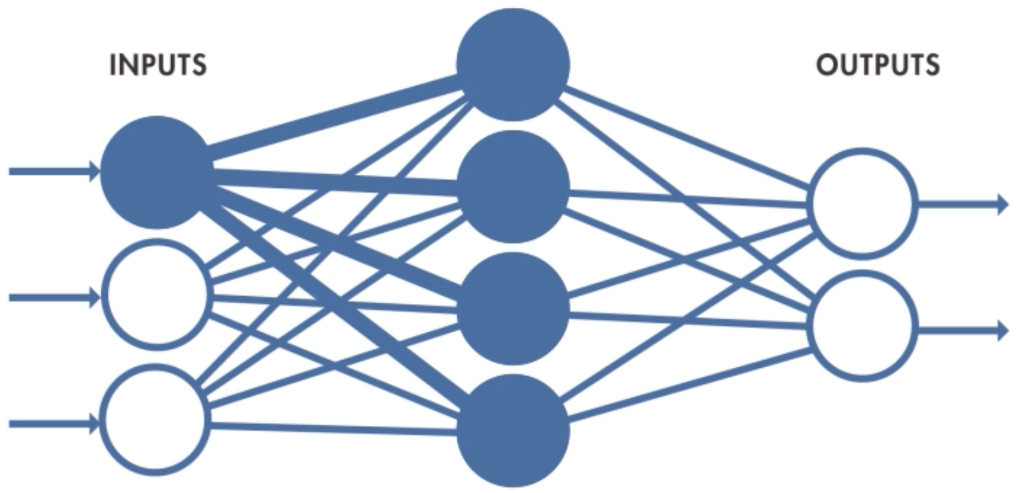
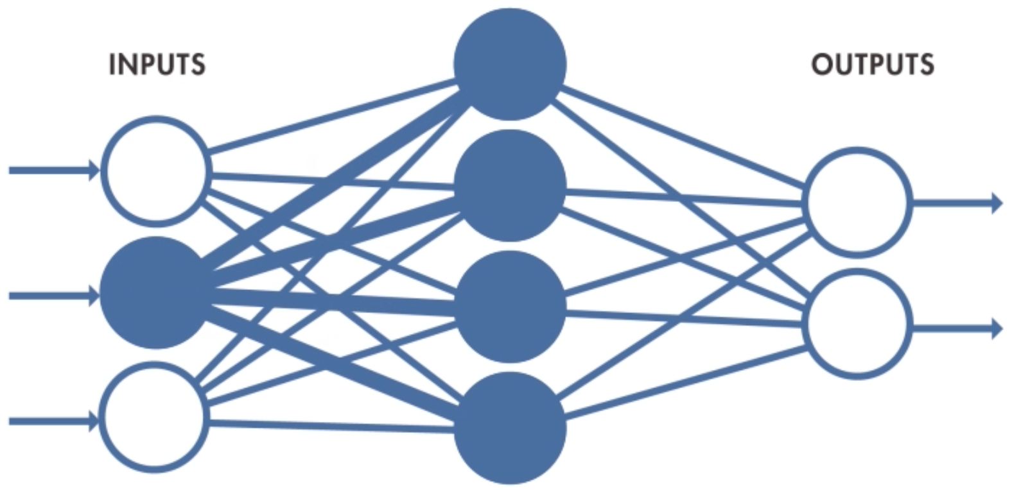
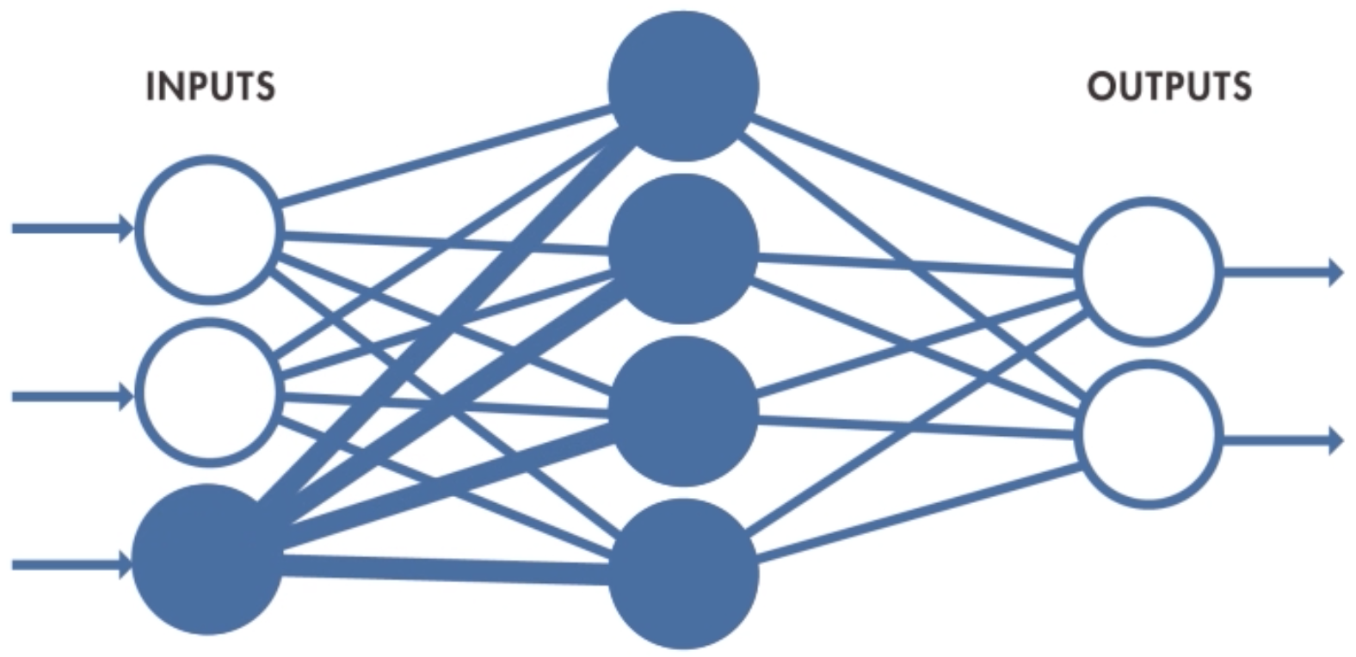
2. Comparison of ANN with CNN in a simple example
Image provided from MathWorks

Slide 5
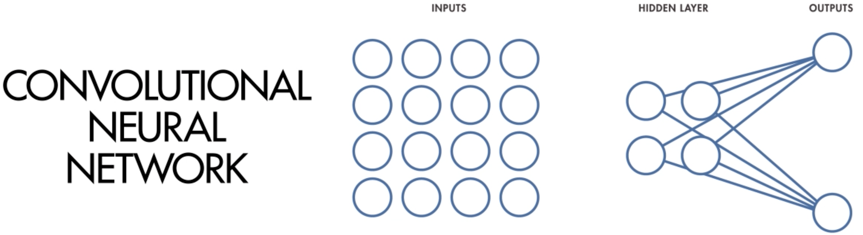
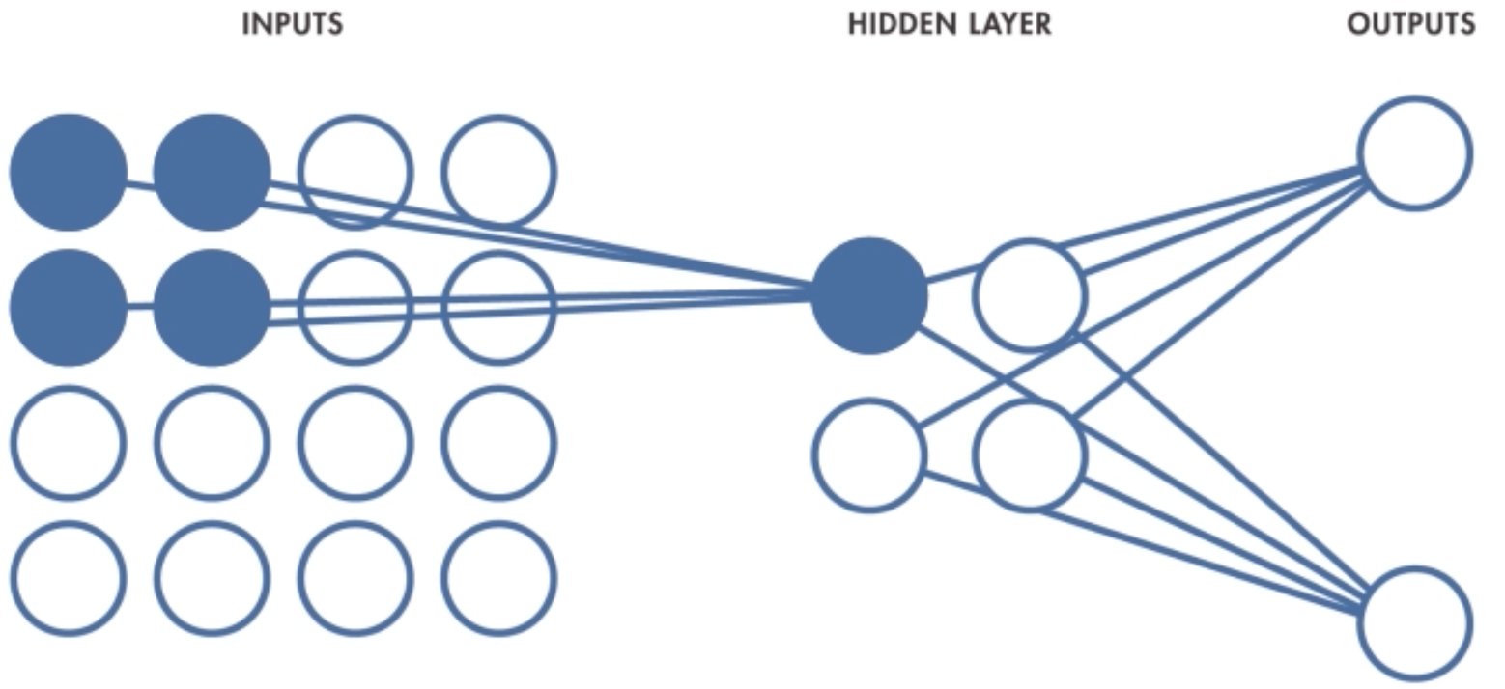
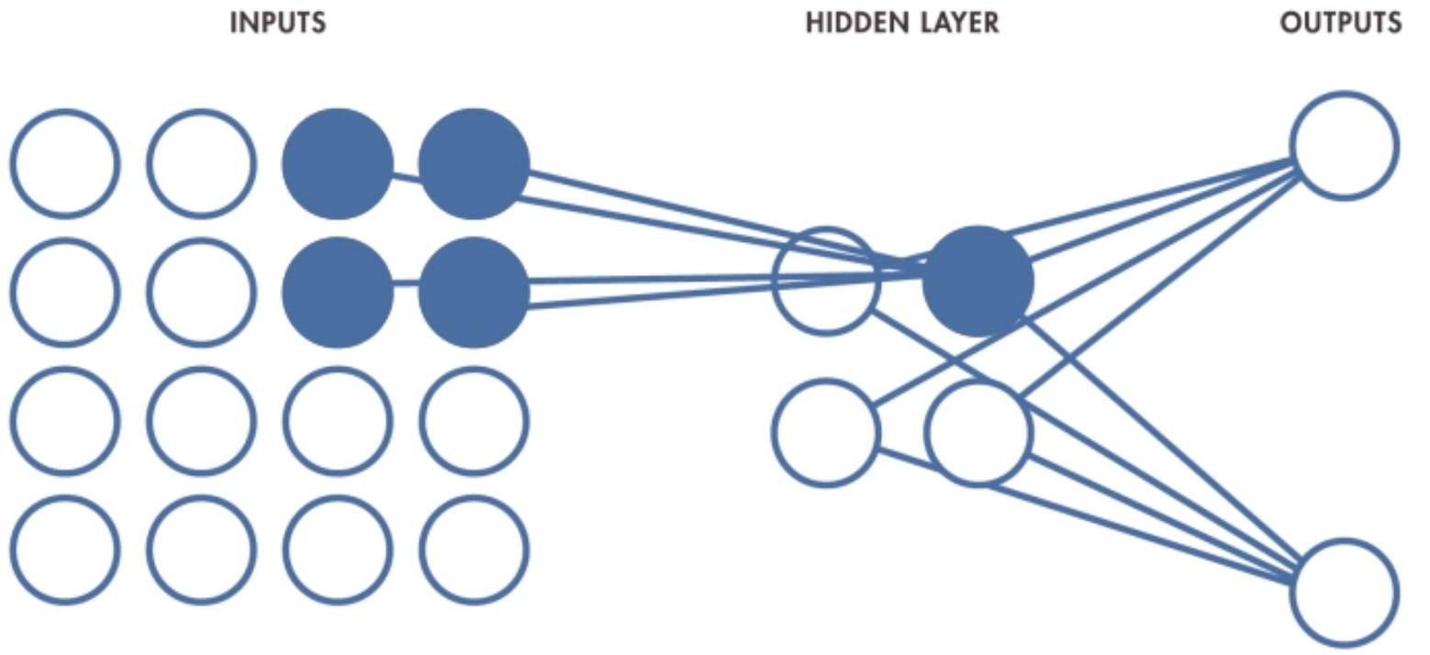
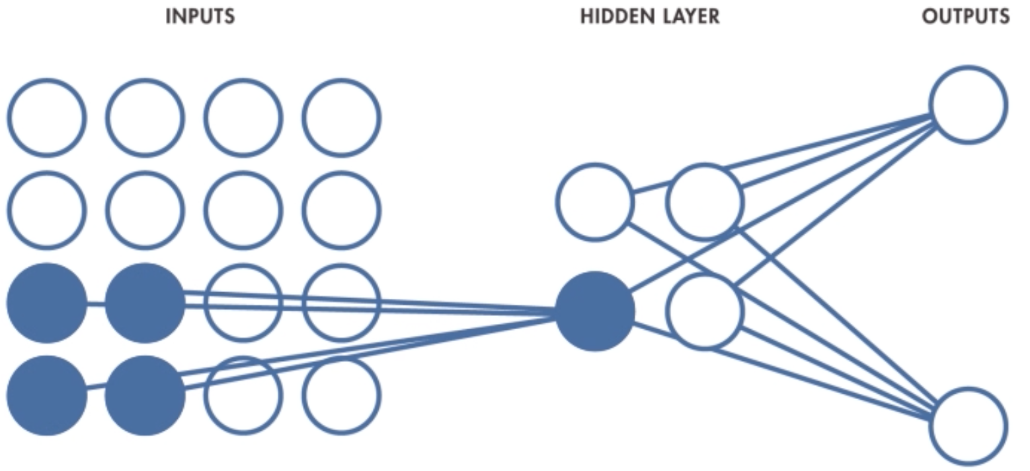
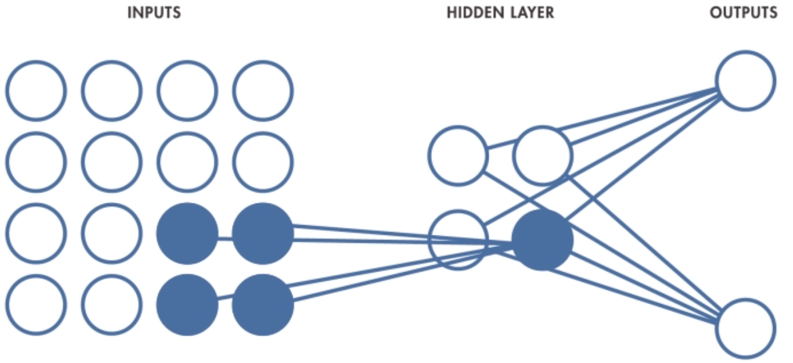
2. Comparison of ANN with CNN in a simple example
Image provided from MathWorks

Slide 6
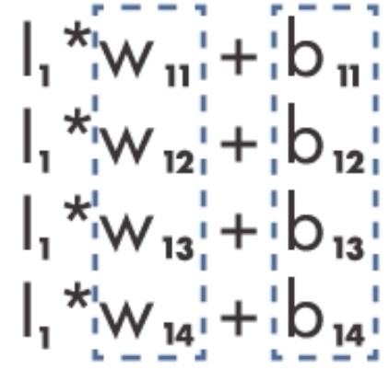
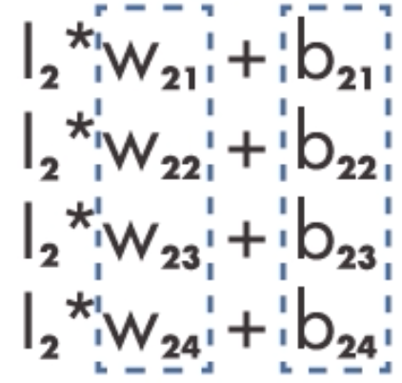

3. The structure of convolutional neural network
Shared weights and biases - ANN
Image provided from MathWorks

Slide 7
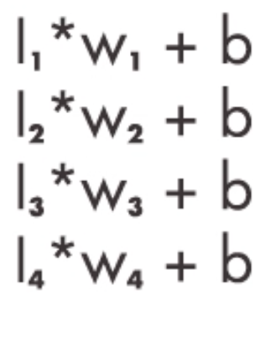
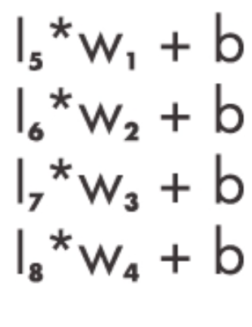
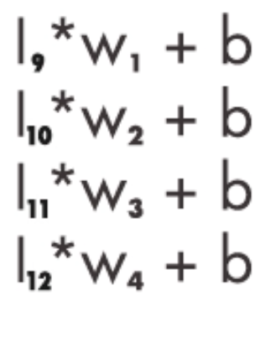
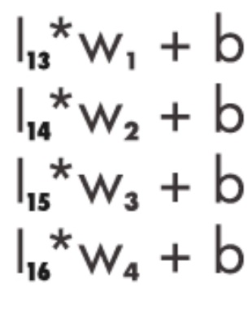
3. The structure of convolutional neural network
Shared weights and biases - CNNs
Image provided from MathWorks

Slide 8
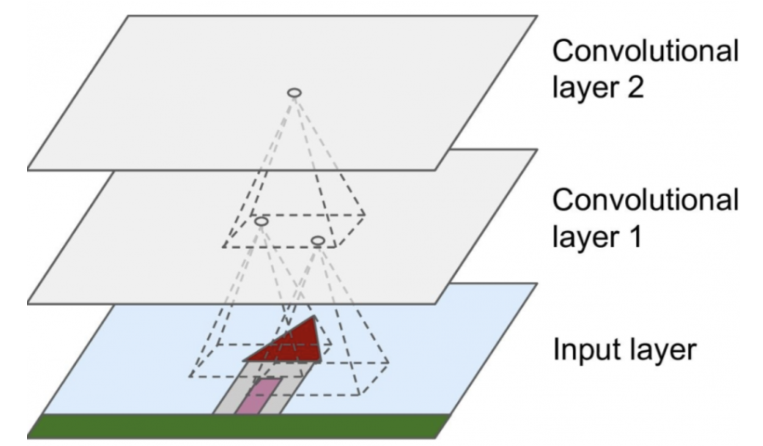
3. The structure of convolutional neural network
Convolutional Layer
Neurons in the convolutional layer are not connected to every single pixel in the input image but only to pixels in their receptive fields.
This architecture allows the network to concentrate on small low-level features in the first hidden layer, then assemble them into larger higher-level features in the next hidden layer and so on.

Slide 9
3. The structure of convolutional neural network
R1 | R2 | R3 | R4 | R5 | R6
R7 | R8 | R9 | R10 | R11 | R12
R13 | R14 | R15 | R16 | R17 | R18
R19 | R20 | R21 | R22 | R23 | R24
R25 | R26 | R27 | R28 | R29 | R30
R31 | R32 | R33 | R34 | R35 | R36
w1 | w2
w3 | w4
Kernel
Input Image

Slide 10
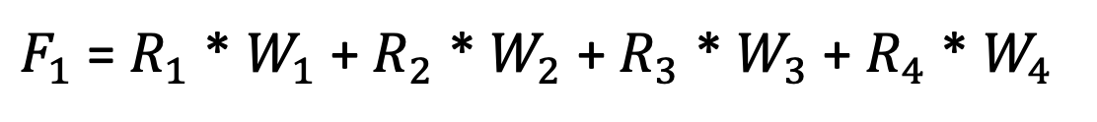
3. The structure of convolutional neural network
w1 | w2
w3 | w4
R1 | R2 | R3 | R4 | R5 | R6
R7 | R8 | R9 | R10 | R11 | R12
R13 | R14 | R15 | R16 | R17 | R18
R19 | R20 | R21 | R22 | R23 | R24
R25 | R26 | R27 | R28 | R29 | R30
R31 | R32 | R33 | R34 | R35 | R36
F1 | F2 | F3 | F4 | F5
F6 | F7 | F8 | F9 | F10
F11 | F12 | F13 | F14 | F15
F16 | F17 | F18 | F19 | F20
F21 | F22 | F23 | F24 | F25
Feature Map
Input Image
$F_{1}$ = $R_{1}$ * $W_{1}$+ $R_{2}$ * $W_{2}$ + $R_{3}$ * $W_{3}$ + $R_{4}$ * $W_{4}$

Slide 11
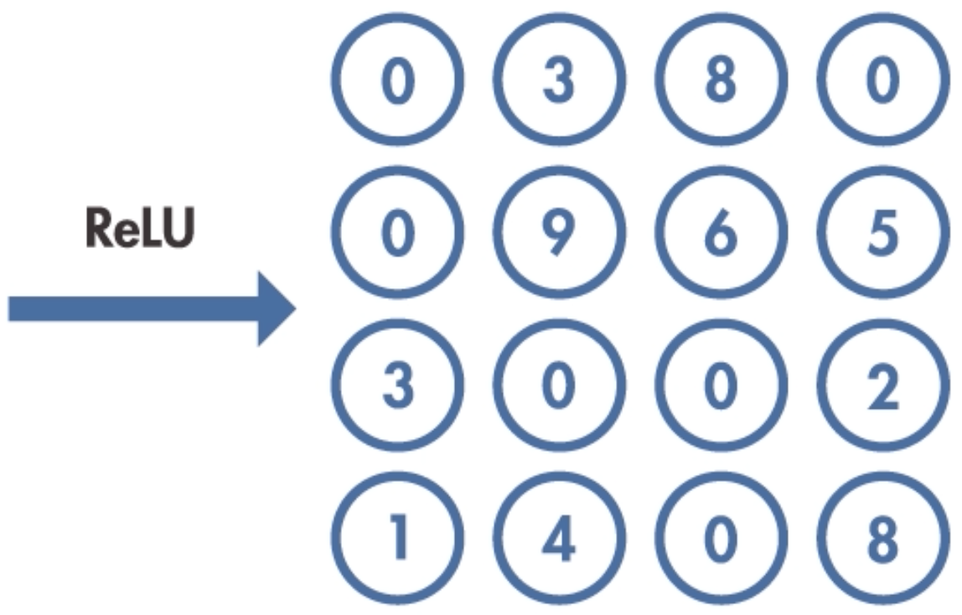
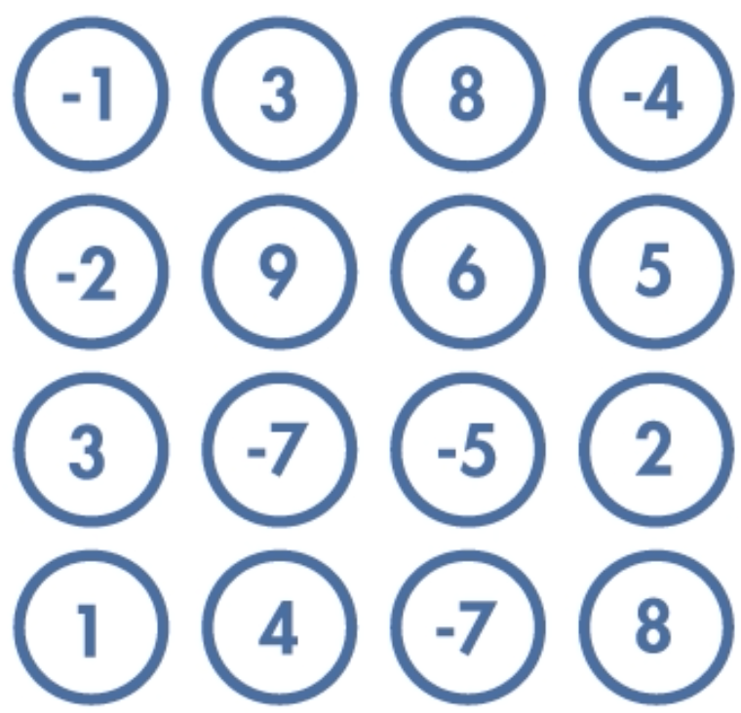
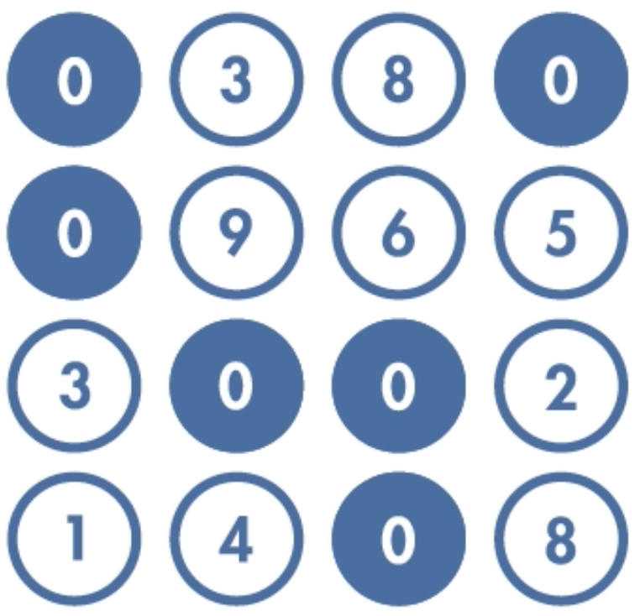
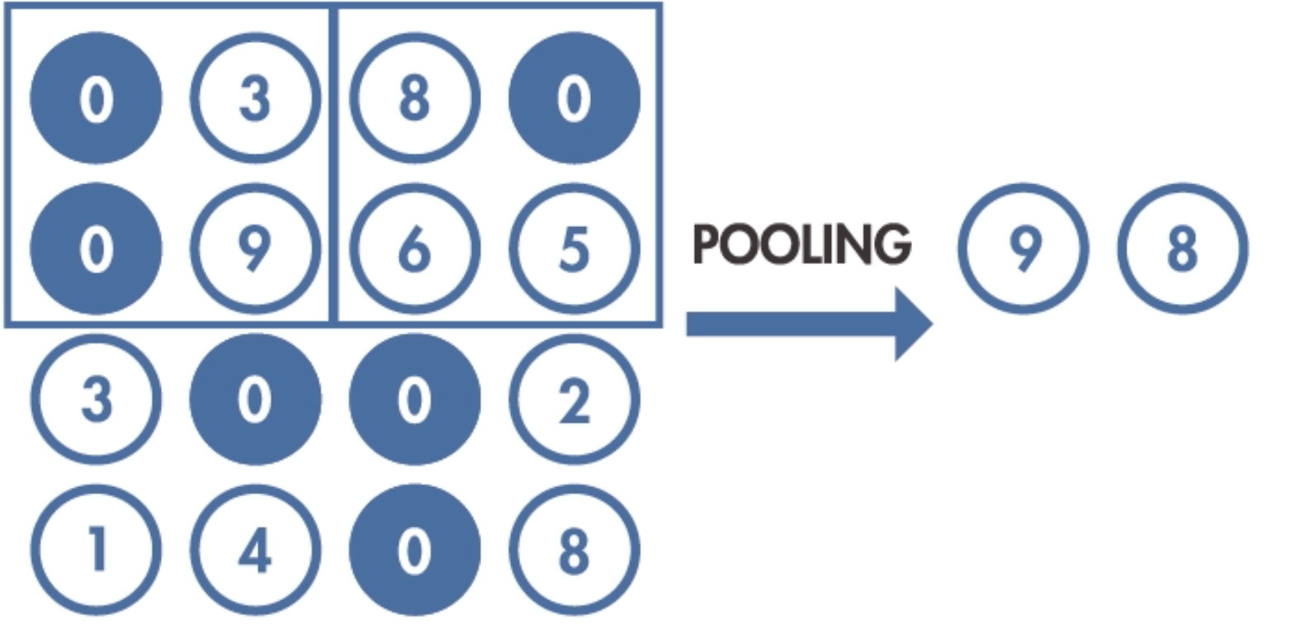
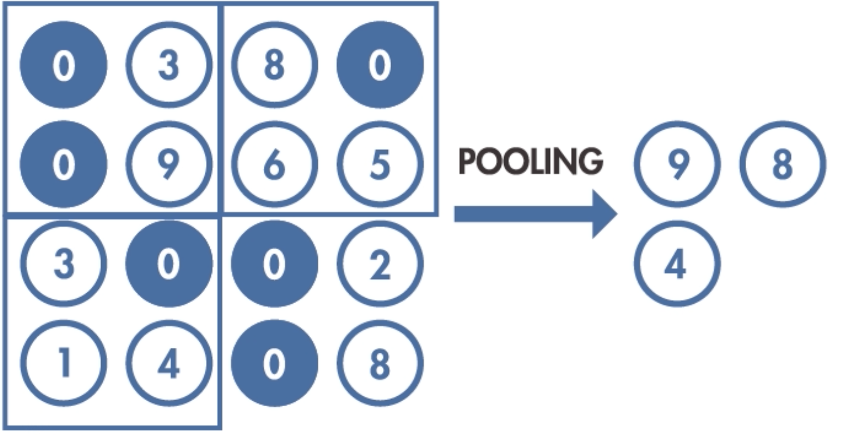
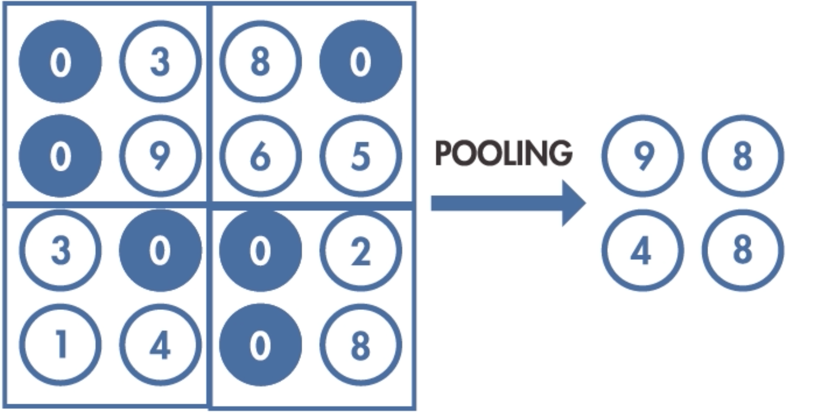
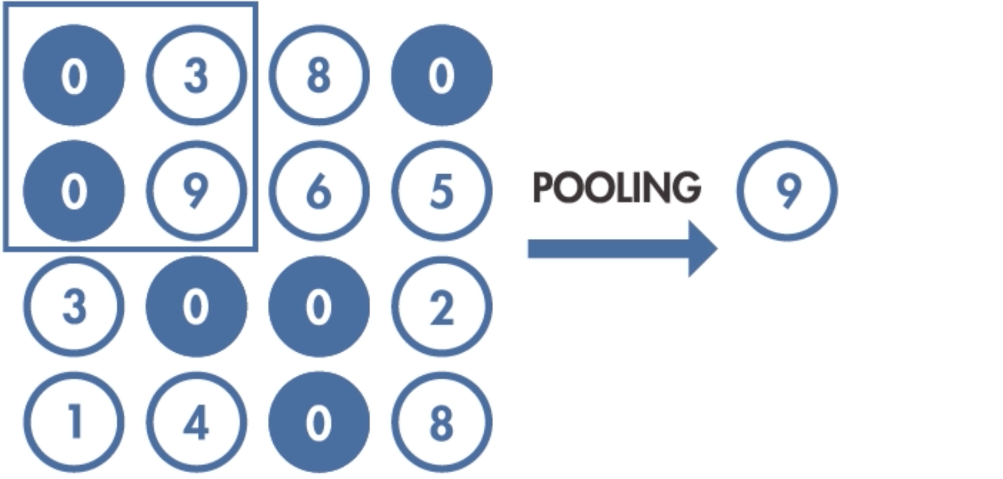
3. The structure of convolutional neural network
Activation and pooling
3
4.7
2
2.5
Max Pooling
Average Pooling
Image provided from MathWorks

Slide 12
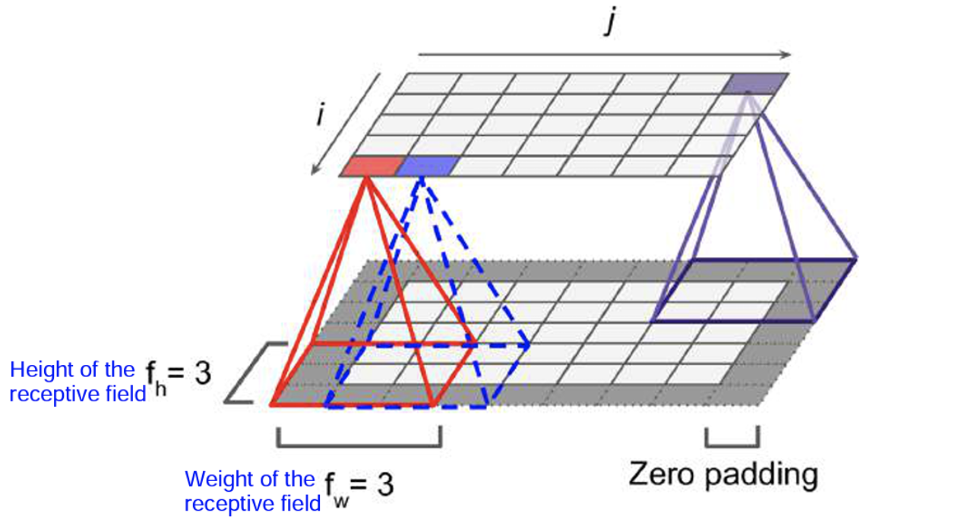
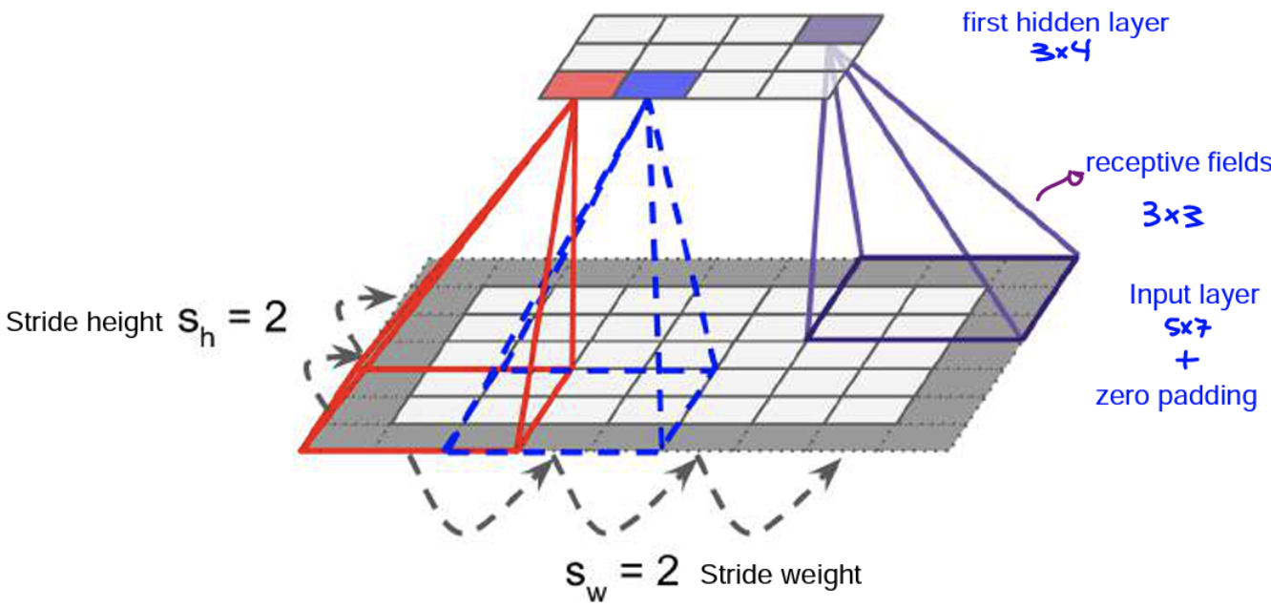
3. The structure of convolutional neural network
Stride and Padding
Connections between layers and zero padding
Reducing dimensionality using a stride of 2

Slide 13
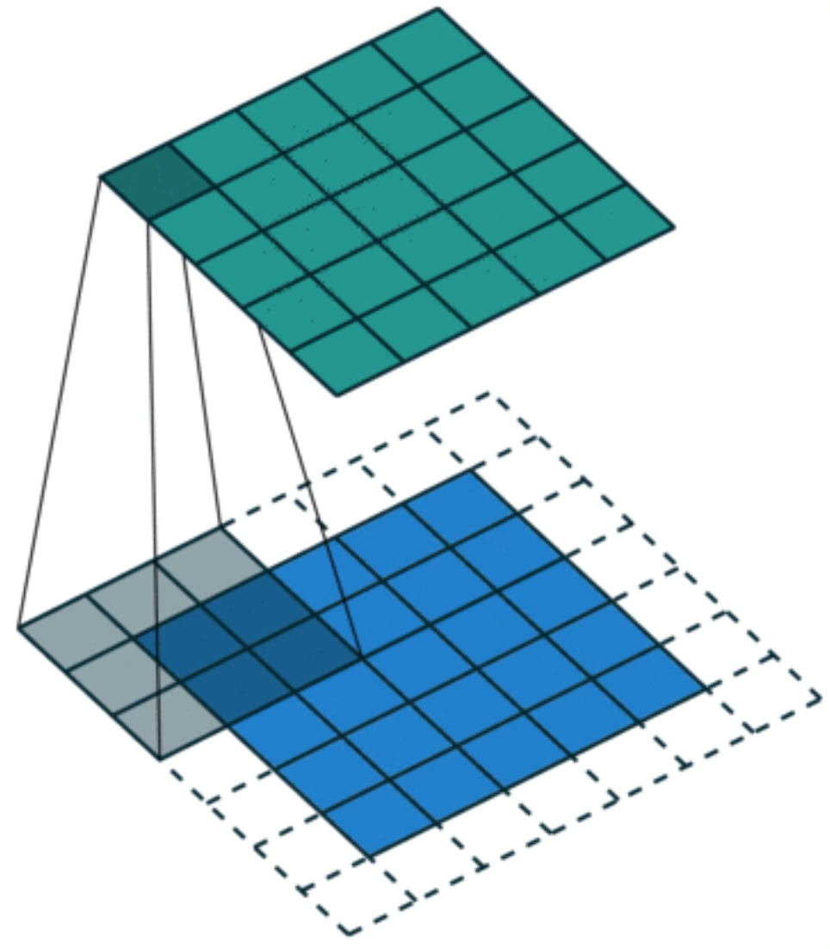
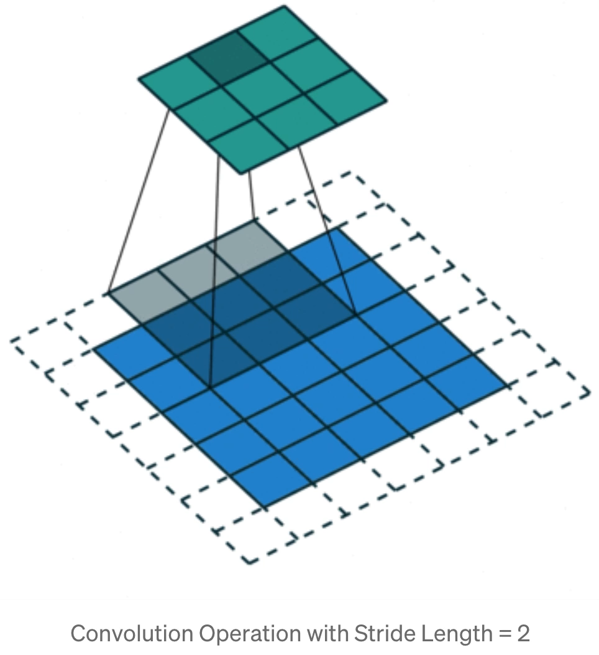
3. The structure of convolutional neural network
Stride and Padding
Image provided from MathWorks

Slide 14
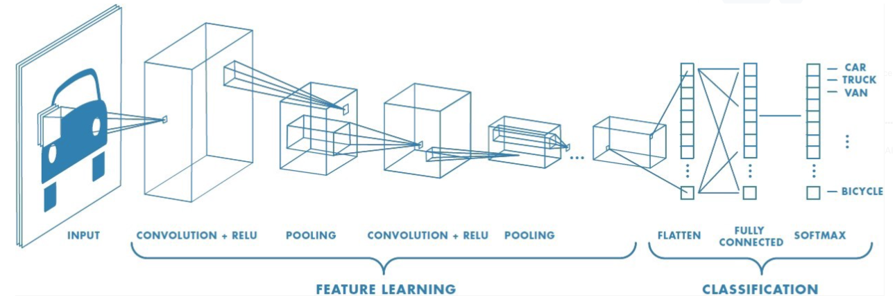
3. The structure of convolutional neural network
Schematic representation of a convolutional neural network with two hidden layers
Image provided from MathWorks

Slide 15
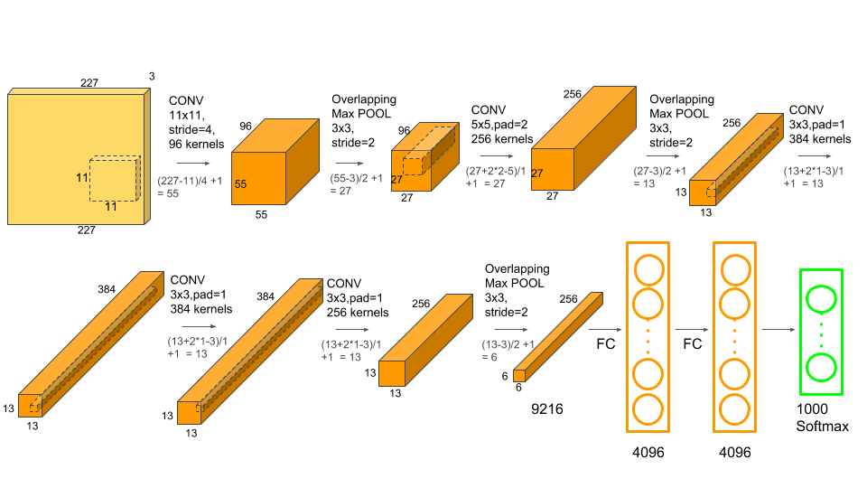
4. Looking at different CNN structure
AlexNet – won the 2012 ImageNet challenge
Image provided from LearnOpenCV

Slide 16
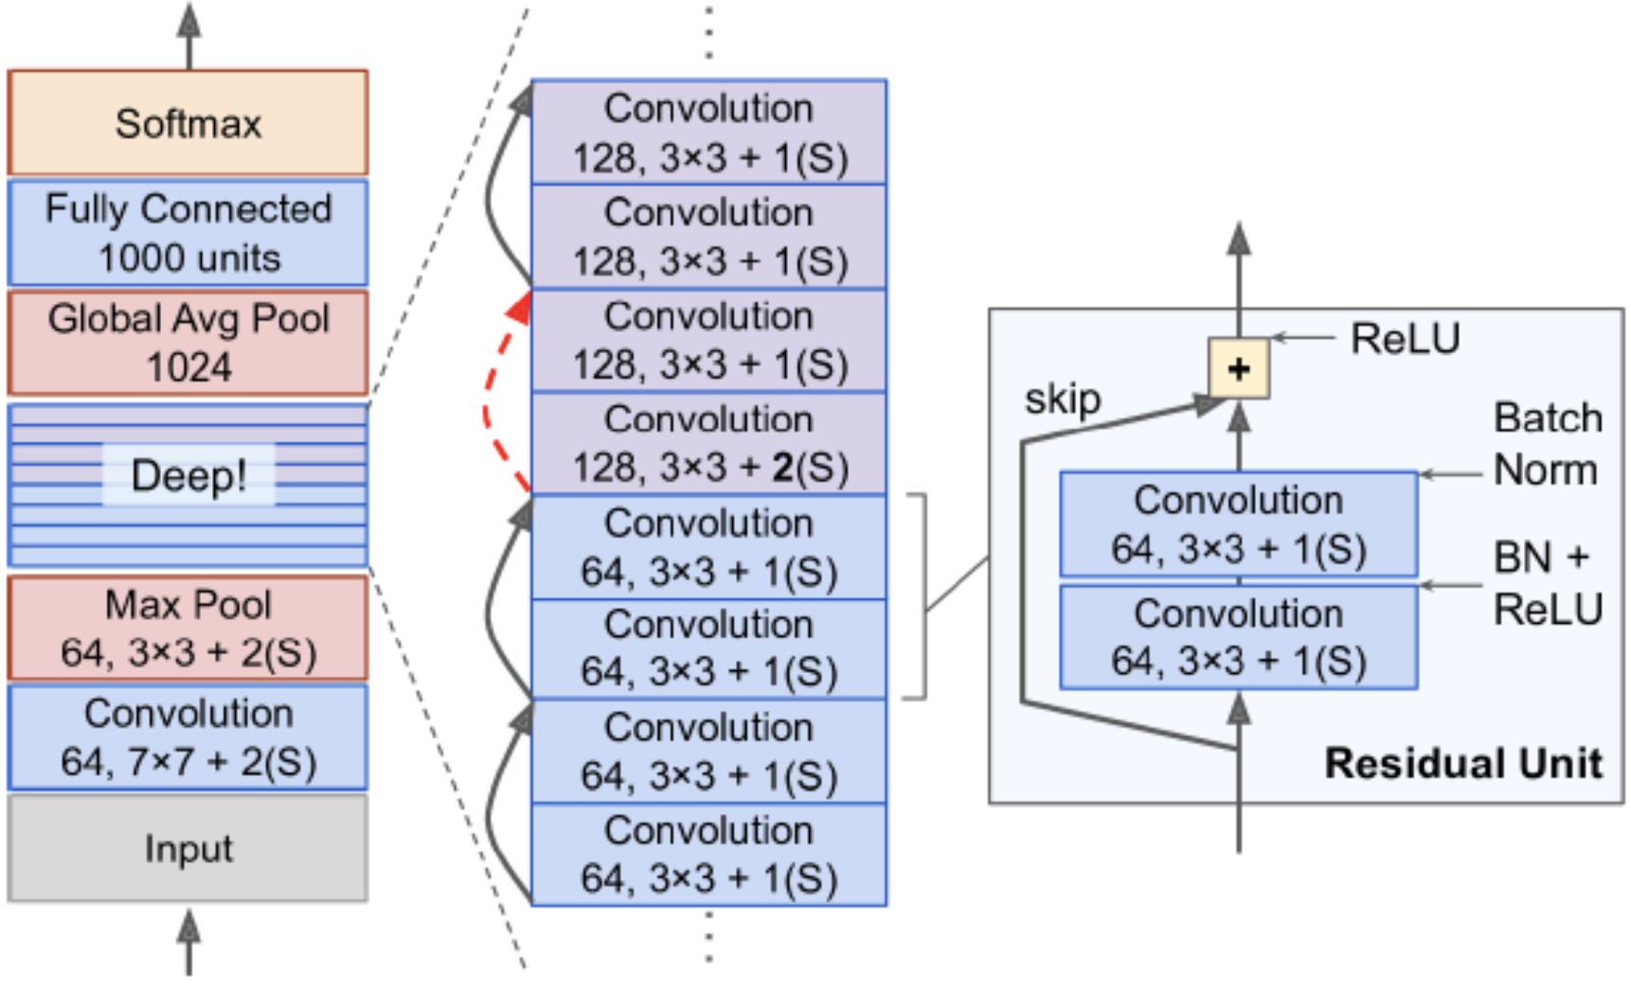
4. Looking at different CNN structure
ResNet
Image provided from https://jason-adam.github.io/resnet50/

Slide 17
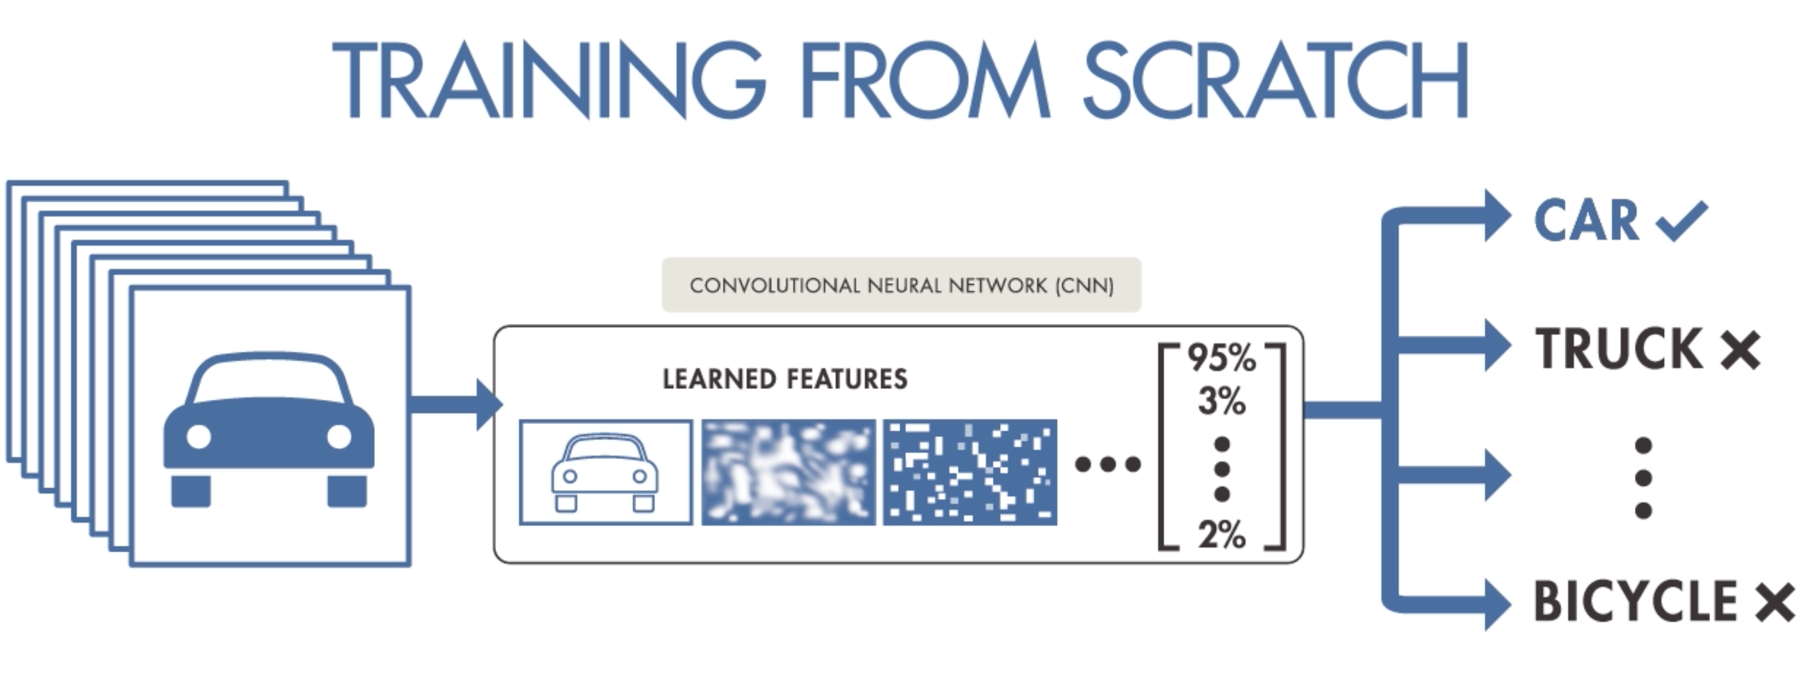
5. How to code convolutional neural network in python
Image provided from MathWorks

Slide 18
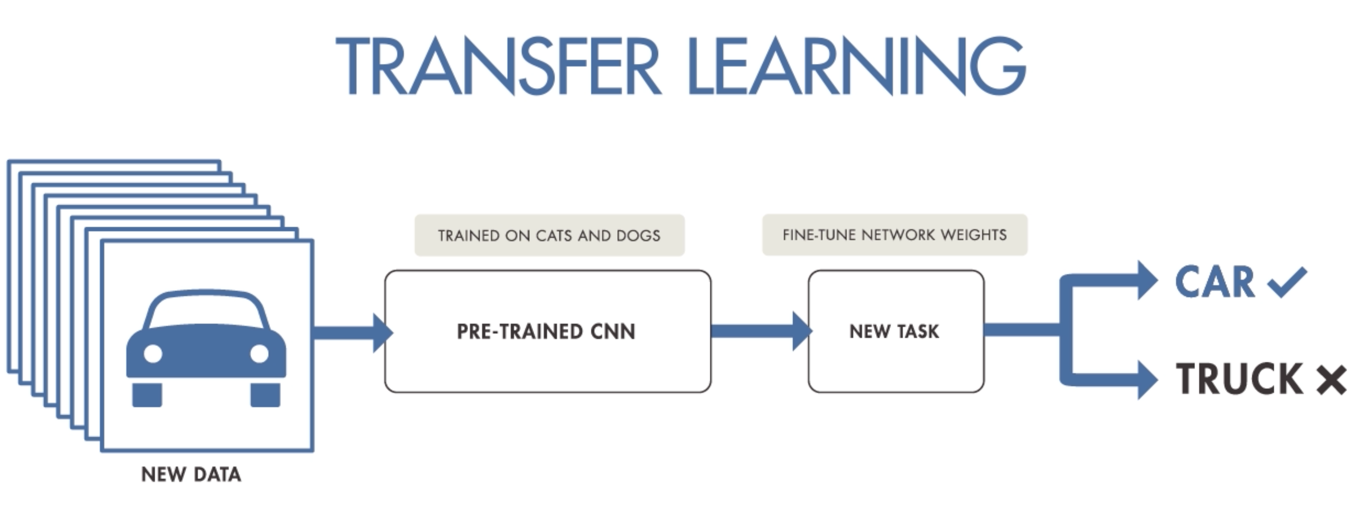
5. How to code convolutional neural network in python
Image provided from MathWorks

Slide 19
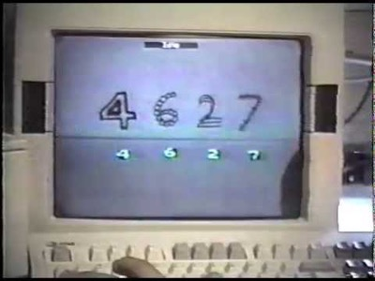
6. Hands on project
Convolutional Network Demo from 1993

Slide 20
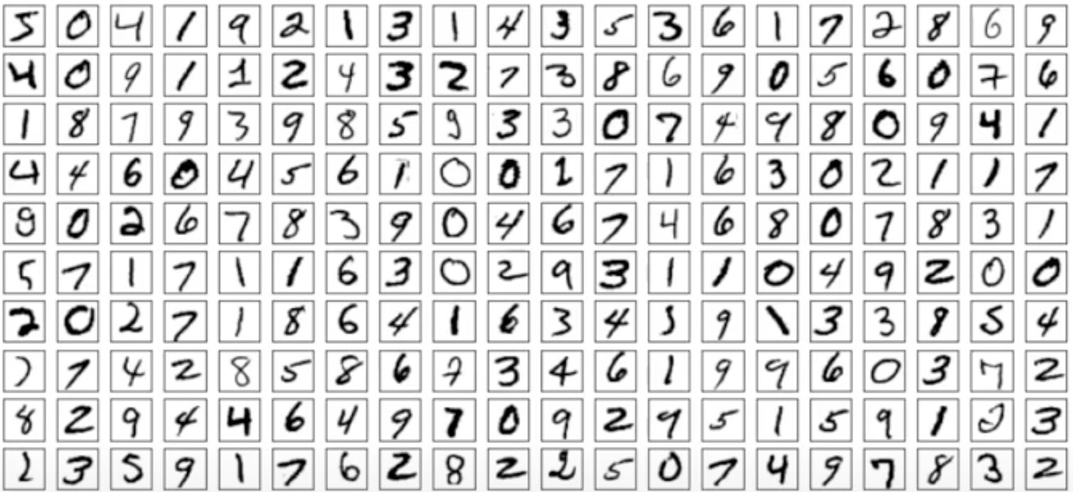
6. Hands on project
We are going to use the handwritten digit dataset and using convolutional neural network for digit classification
Open your Jupyter Notebook for the rest …

